Slide 1
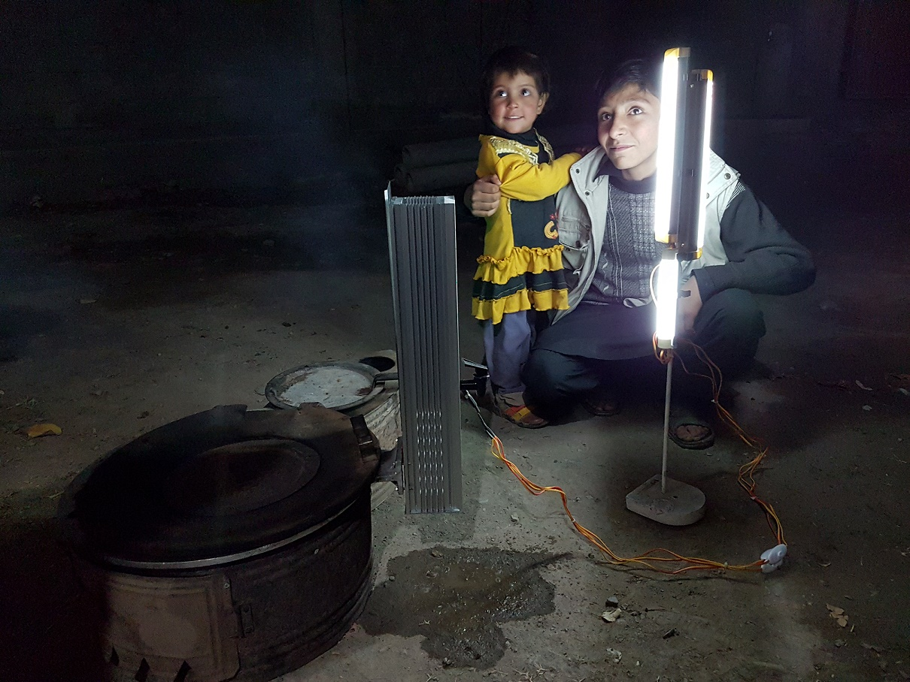
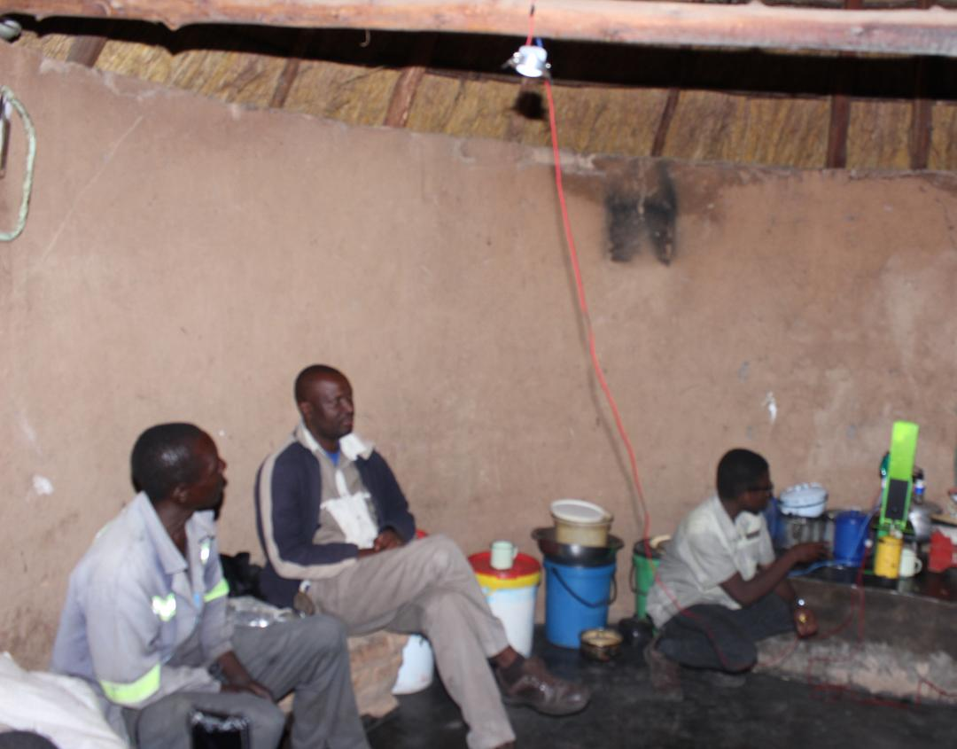
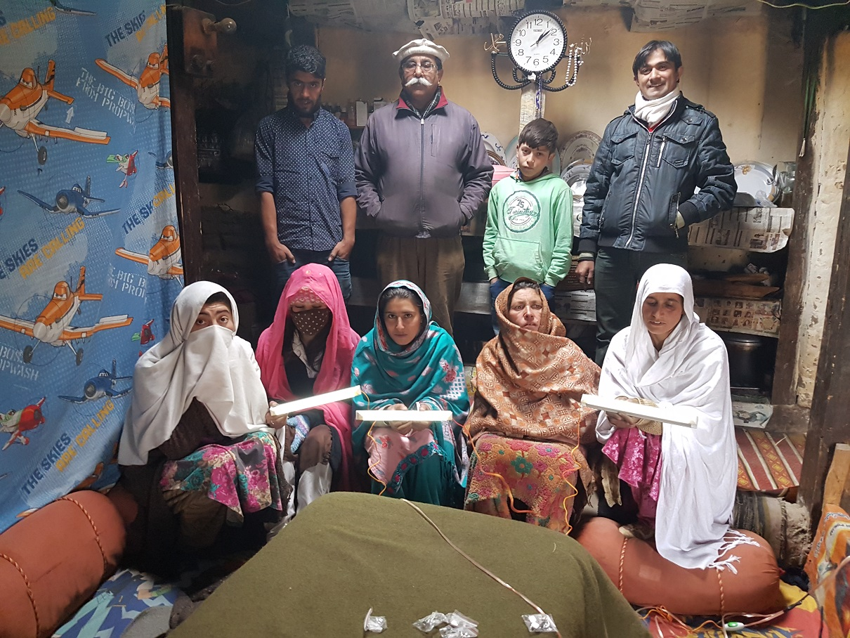
GYSK Energy Lighting up lives™
Environmentally, distributed POWER products for the masses!
ON DEMAND
No Infrastructure required!
No Power Plants or Power Lines!
If you Heat or Cook you can produce power!
Contact:
25 Signal Hill Ave.
Etobicoke, Ontario
Canada
M9W6V8
1-647-403-1999
gyskenergy@gmail.com

Slide 2
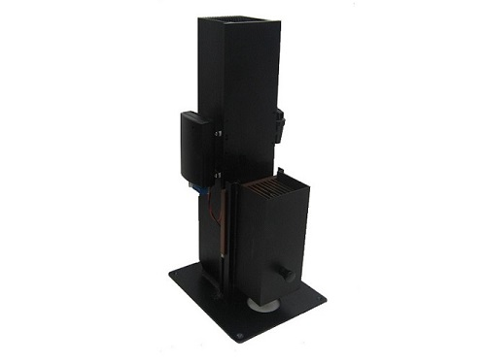
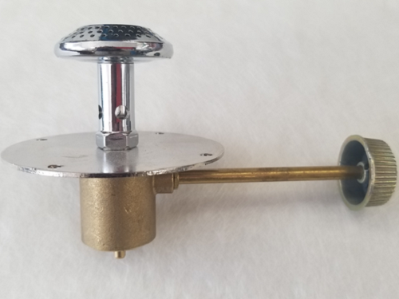
Option 1:
IPOWERTOWER™
Independent either Gas Burner, or Ethanol Gel as energy source.
Multi-purpose Thermoelectric Solid-state Generator. Emergency power for charging batteries, charging cell phones, LED lights, Radio, Tablets.
5V USB and 1.2V to 12V aux terminal. Silent running just add 1.2 liters of water and good quality high temperature heat.
10 watts nominal power output
Charges cell phones
Runs LED DC lights
6.4 lbs. net weight adjacent model
Different configurations for a verity of heating appliances
Almost entirely constructed of Anodized Aluminum
Equipped with water tap for dispensing hot water
DC to DC controller for plug and play charging
2 Hour Burn
NGL or Propane

Slide 3
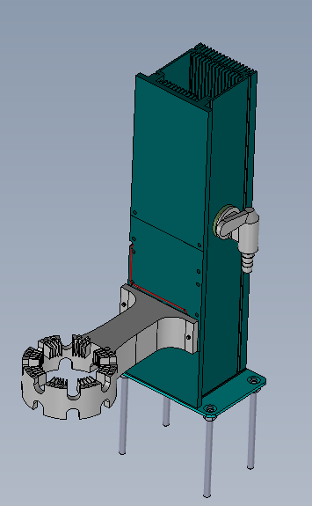
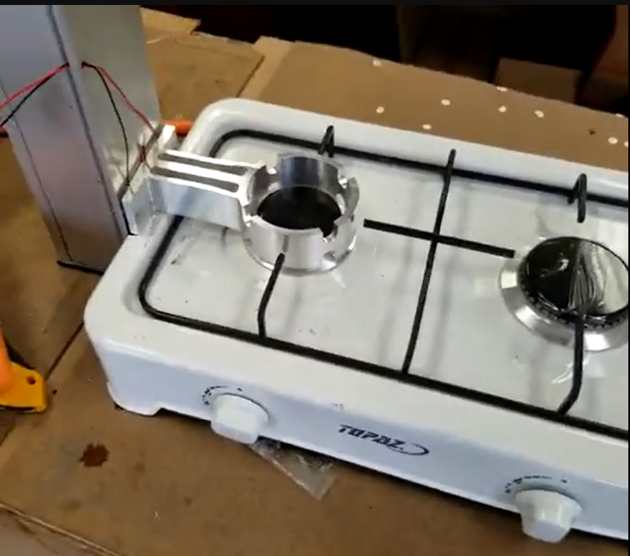
Gas Stove IPOWERTOWER™
Option 2:
-Designed to site on the side of a Gas table top stove and scavenge heat from the burner while cooking a meal!
-Equipped with a water Tap to dispense hot water.
-Adjustable feet for any height Gas stove burner up to ~15cm from counter surface.

Slide 4
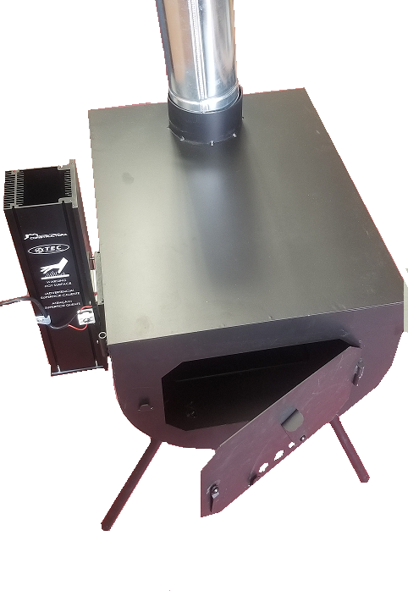
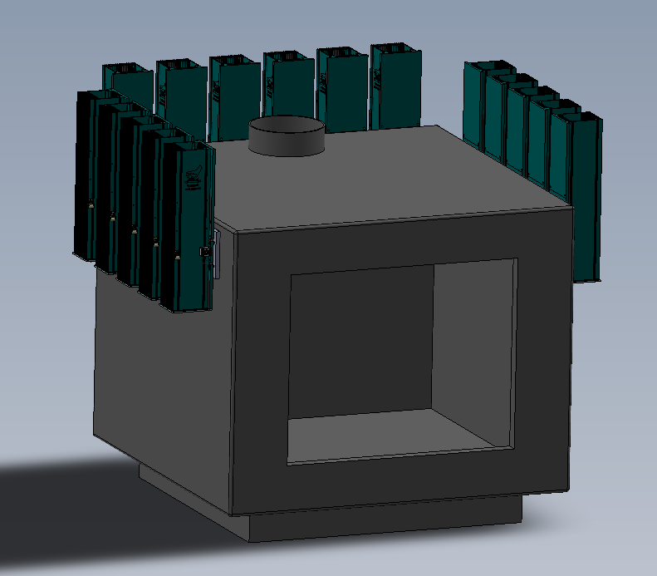
Option 3:
Wood stove heat source. Optional up to 16 units or more for a total of 160 watts from a single wood stove!(Based on Stove size)
4 Kwh of power over a 24 hr. period!
Use a single wood stove with multiple IPOWERTOWERS™ for higher power requirements!
Placed on the sides and back of the stove.
****Other systems can be design specifically, to extract heat from other appliance!

Slide 5
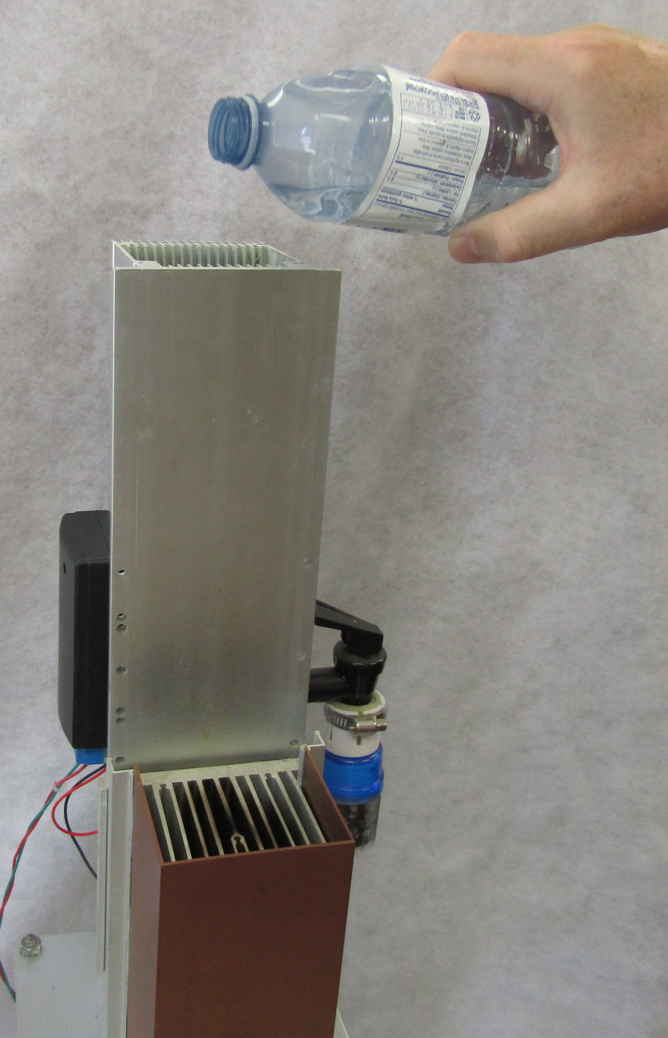
Add 1.2 liters of water or any liquid you have
at your disposal to the heat removal tower.

Slide 6
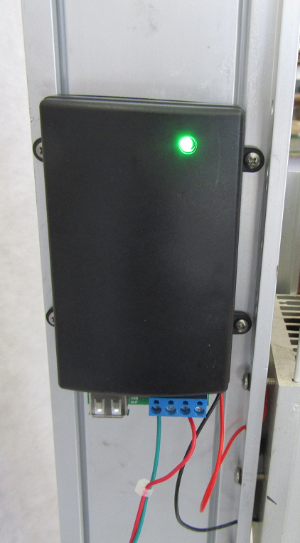
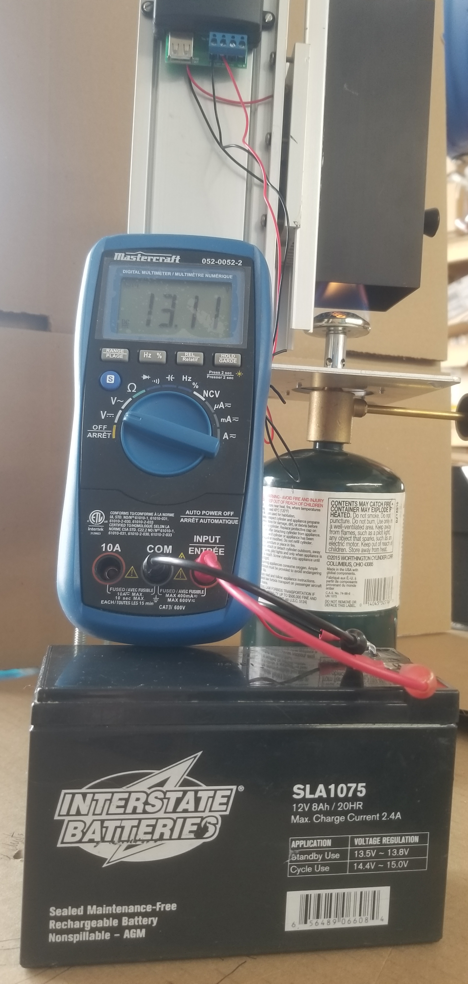
Add good quality heat to the hot side heat adsorber sink.
The green light will turn on when the system reaches Minimal charging power strength. It takes about 3 to 4 minutes to reach full power output.
12V battery charging!

Slide 7
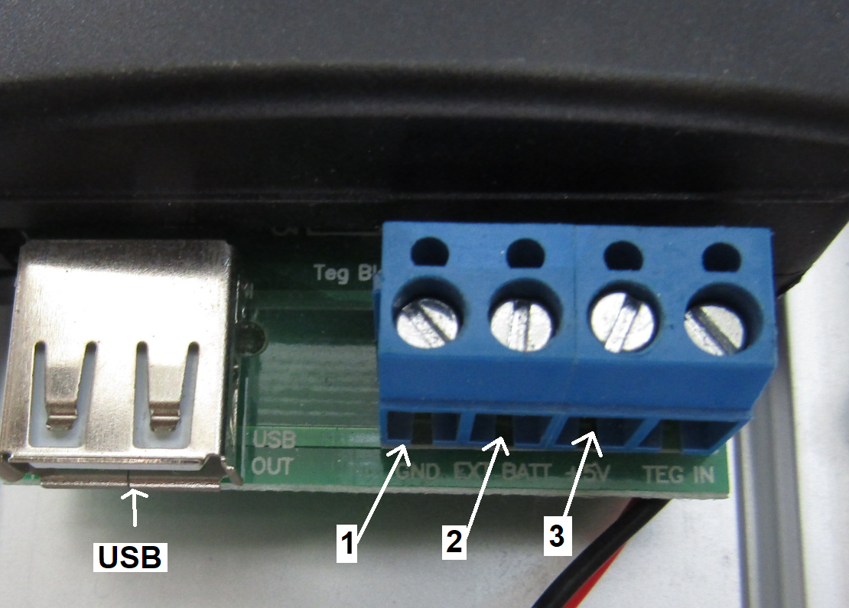
(1) Black negative wire from any DC Load( Motor, Fan, LED light)
(2) 12V RED Positive to any Dc load ( motor, fan, LED light, radio)
(3) 5V Positive RED which can accept a second RED wire along with 1 Black wire to complete a dc circuit to run a load.
USB will charge a Cell phone or run a load that is under 1 amp for a total of 5Watts. LED lights and appliances that are 5V.
USB is limited to 5watts maximum charging. The 12V AUX connector is capped at .275ma to protect the 5V side of the circuit. The 12V AUX can trickle charge a 12V battery at 13.8V and can charge batteries low at 1.2V up to 20V Auxiliary power for these tasks.

Slide 8
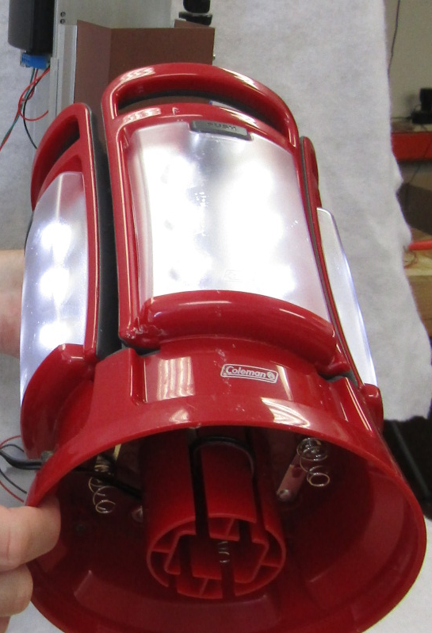
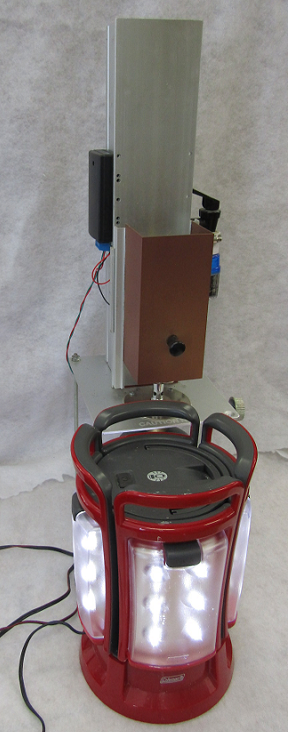
The IPOWERTOWER™ can easily run a 12V Lantern or string of 5 or 12V DC Lights with a Gas Burner on low flame. Controller can be adapted to meet specific load appliances ( DC Radio’s, DC LED lights, Cell phone, Tablets, etc…

Slide 9
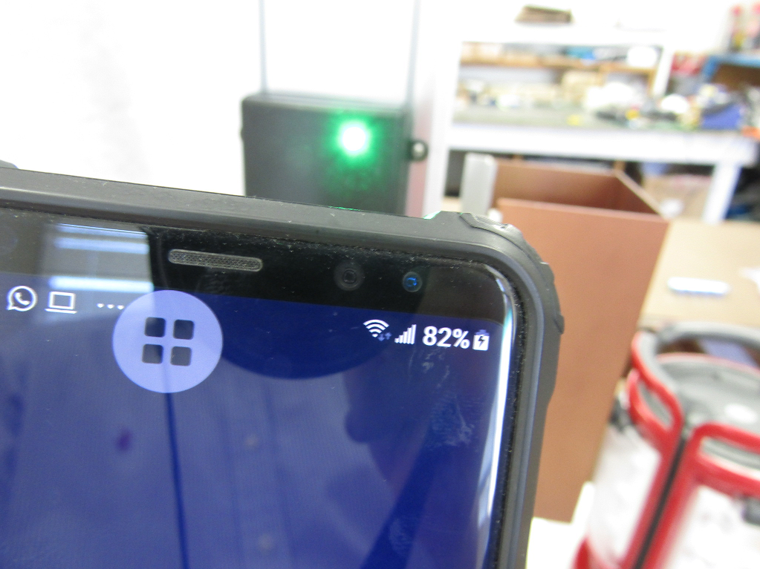
The IPOWERTOWER™ 5V USB charges a cell phone, tablet as if it was plugged into a wall plug at home with a good quality heat source.
Offered in Black only.
Gross weight 8 lbs
Package size 19” x 8” x 9” ( Depending on Model) **subject to change
Contact:
Patented

Slide 11
GYSK Energy Lighting up lives™
Environmentally, distributed POWER products for the masses!
ON DEMAND
No Infrastructure required!
No Power Plants or Power Lines!
If you Heat or Cook you can produce power!
Contact:
25 Signal Hill Ave.
Etobicoke, Ontario
Canada
M9W6V8
1-647-403-1999
gyskenergy@gmail.com

